Slide 1
Digital Portfolio
STUDENT NAME: E.sudha
REGISTER NO AND NMID: 24134031802522050,asanm40324134031802522050
DEPARTMENT: B.sc computer science 2nd year
COLLEGE:Ps.pt.MGR arts and science college Puthur sirkali

Slide 2
PROJECT TITLE machine learning Models

Slide 3


AGENDA
Problem Statement
Project Overview
End Users
Tools and Technologies
Portfolio design and Layout
Features and Functionality
Results and Screenshots
Conclusion
Github Link
3/21/2024 Annual Review

Slide 4

PROBLEM STATEMENT briefly explain the real-world problem you are trying to solve with your project

Slide 5

PROJECT OVERVIEW Give a high-level summary of your project,including the data set and the main goal

Slide 6

WHO ARE THE END USERS? Identify who will benefit from your project ex:specific people,industries,etc..

Slide 7

TOOLS AND TECHNIQUES List the software and ibararies you used,like python,tensorflow,or pytorch

Slide 8
POTFOLIO DESIGN AND LAYOUT
Explain how you structured your projects presentation or portfolio
8

Slide 9
FEATURES AND FUNCTIONALITY Describe the key function so your model and what it can do

Slide 10
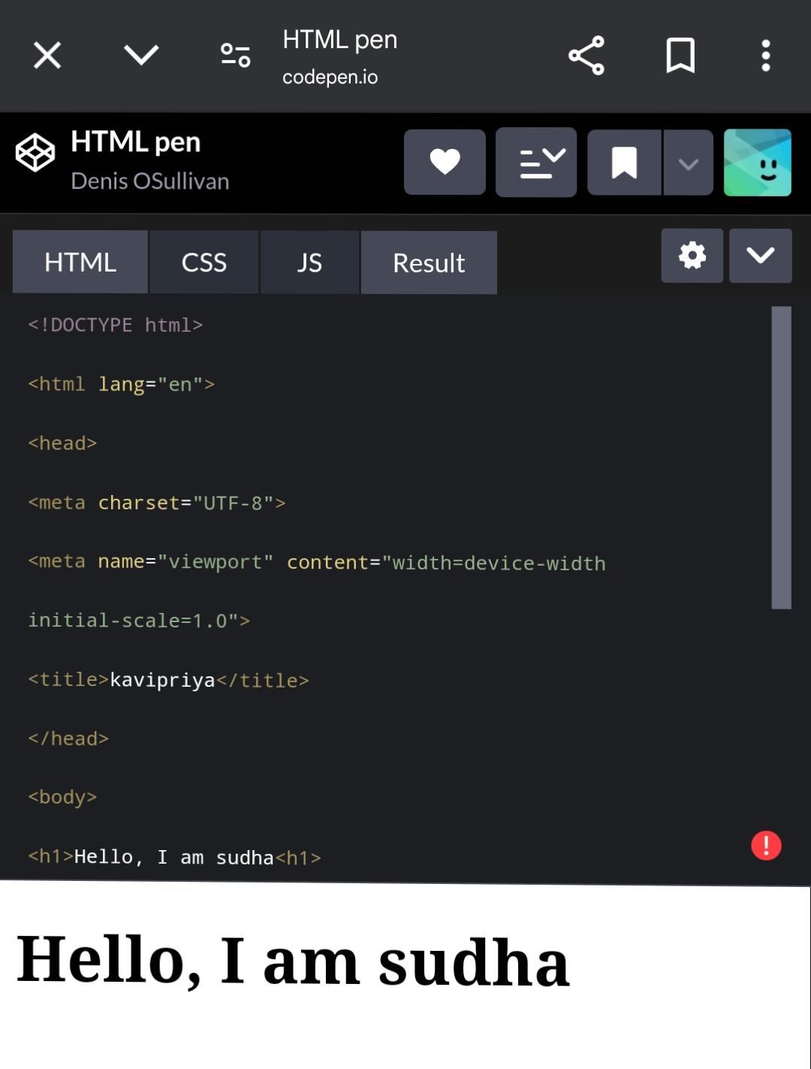
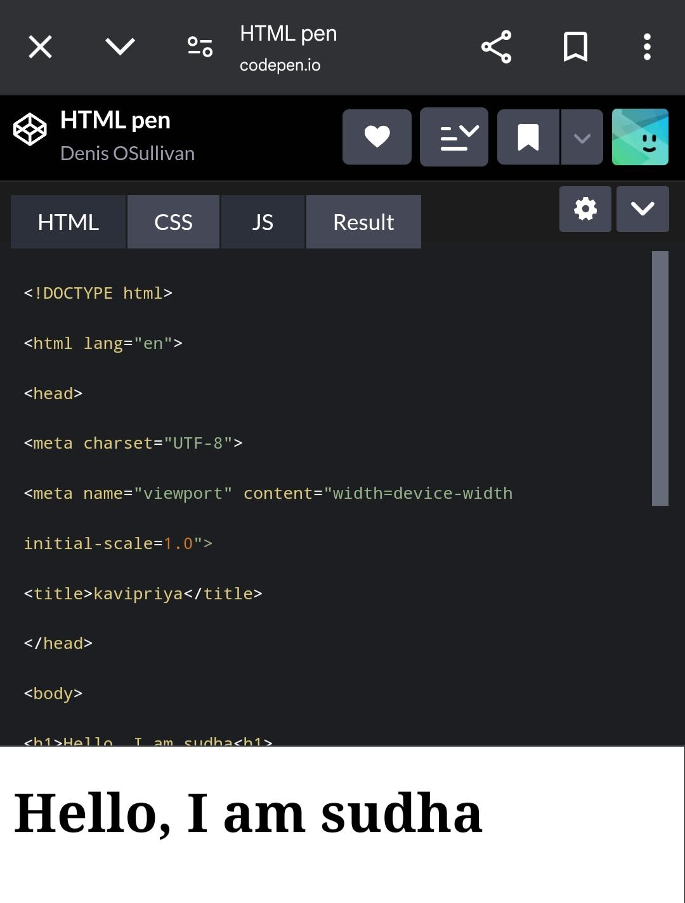

RESULTS AND SCREENSHOTS
3/21/2024 Annual Review
10

Slide 11
CONCLUSION Summarize your finding lesson learned and future steps
11

